Slide 1
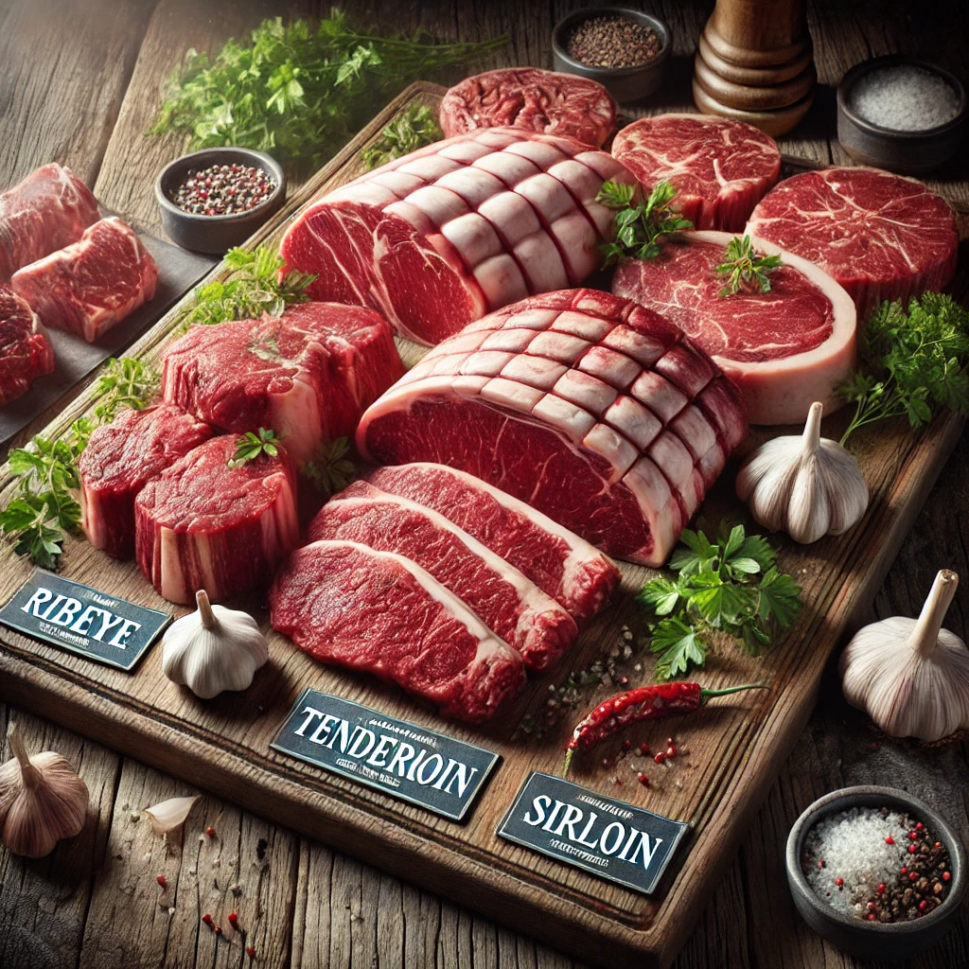

MGMT 68700 ai for business decisions Team Project
Analyzing Primal Beef Market

Slide 2
Scope and goals
Objective: Competitor Analysis and Sales Prediction for Manufacturer 69: Strategies to Enhance Market Share in the Primal Beef Category
Focal Brand: 69; Competitor Brands: 2852 and 2854
Business Problem: How can Manufacturer 69 effectively enhance its market share and sales in the primal beef category while leveraging its strengths, learning from competitor strategies, and avoiding costly mistakes?

Slide 3
Key AREAS For Analysis
Quarterly Sales Prediction: Develop predictive models for quarterly sales of the focal brand and competitors using key factors like retail discounts, market share, sales growth, coupon redemption rates, and temporal variables.
Consumer Behavior Analysis
﻿Segment customers based on demographic attributes and purchasing patterns.
﻿﻿Identify insights to enhance promotional targeting thereby reducing ad cost and improving customer retention
﻿Campaign Performance Evaluation
Assess the effectiveness of campaigns on sales performance for each competitor.
﻿﻿Identify high performing strategies that Manufacturer 69 can adopt to boost sales and gain competitive advantage.

Slide 4

Plan of action
Exploratory Data Analysis
Data Preprocessing
Data Cleaning and Preparation
Model Execution and Analysis
Insight Generation
Conclusion and Recommendations

Slide 5
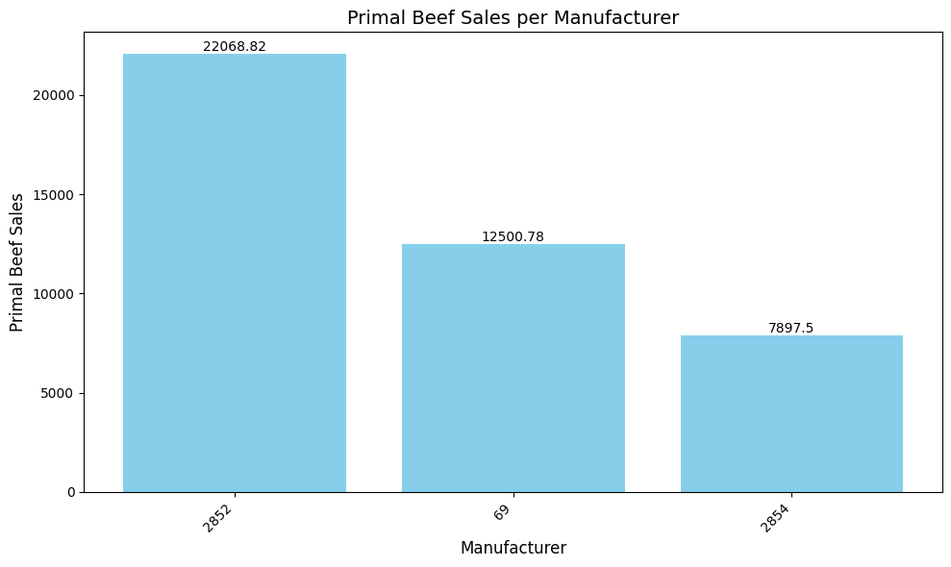
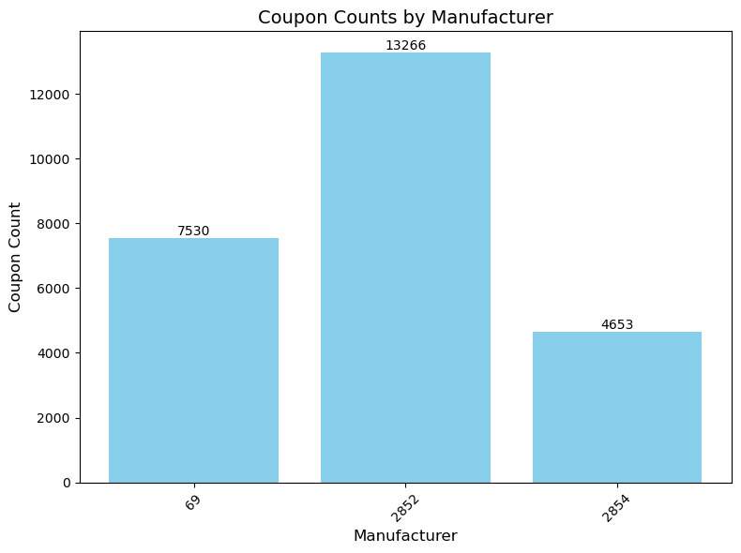
EXPLORATORY DATA ANALYSIs
Why Focus on Primal Beef
Primal Beef emerges as a key category with remarkably high sales and substantial promotional campaign activity.

Slide 6
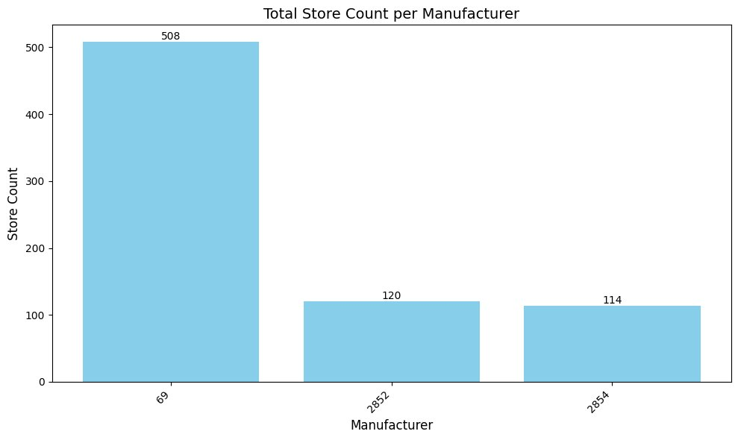
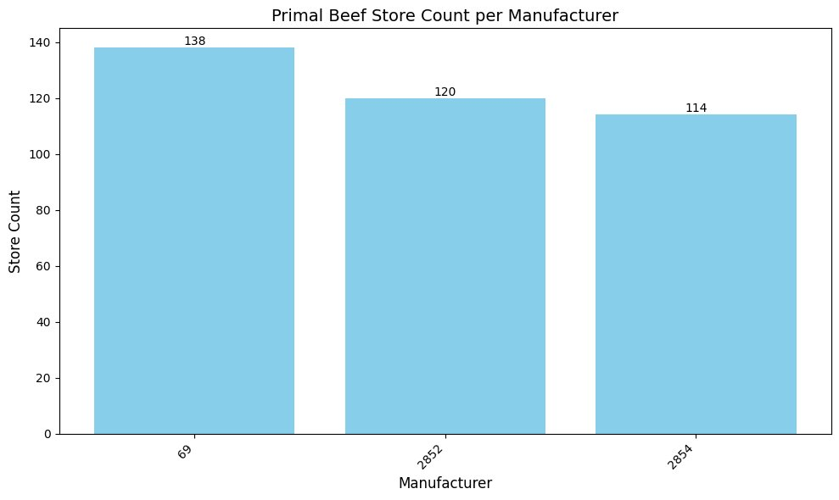
EXPLORATORY DATA ANALYSIs
Why we chose Manufacturer 69 as Focal Brand
Although Manufacturer 69 excels in overall sales and store presence, it falls short in the Primal Beef market, underperforming in terms of sales, store penetration, and promotional efforts.

Slide 7
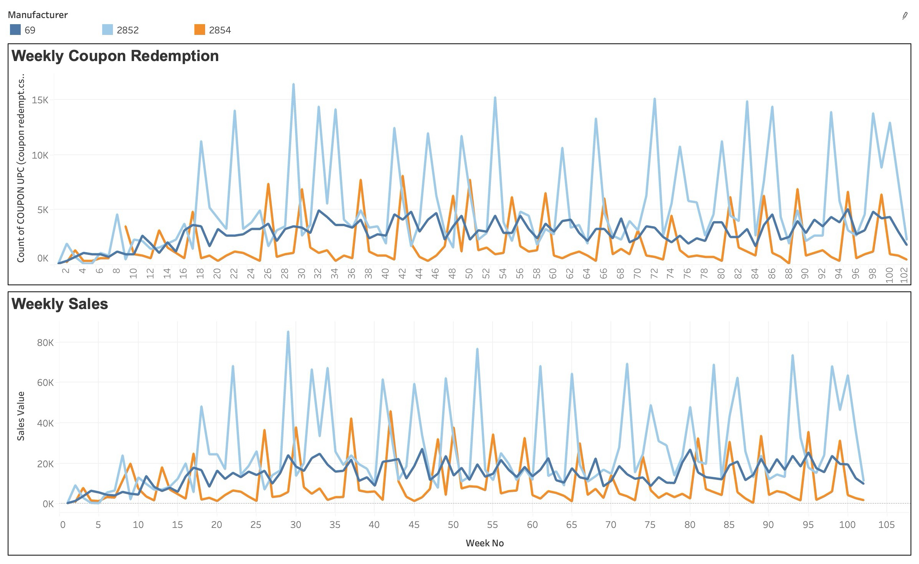
Brand Performance Analysis
2852 effectively uses aggressive promotional campaigns, driving proportional variations in sales and maintaining strong market dominance.
69 leveraging its high brand value, sustains consistent sales despite minimal promotional efforts, showcasing resilience and customer loyalty.
2854 achieves the strongest coupon influence but relies heavily on short-term, timed coupon spikes, limiting its sales growth and sustainability due to a lack of strategy diversification.

Slide 8
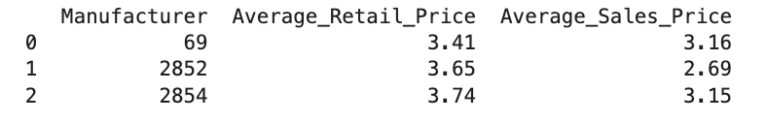
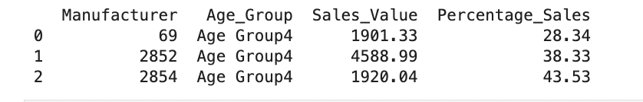
Key Insights from Competitor Analysis
Similar retail prices across competitors suggest similar brand perception.
Manufacturer 2852 dominates due to lower prices and higher coupon usage.
An analysis of product consumption by age group revealed that Age Group 4 is the primary consumer of Primal Beef. Since all brands are already targeting this age group, refining consumer targeting based on age won't be required.

Slide 9
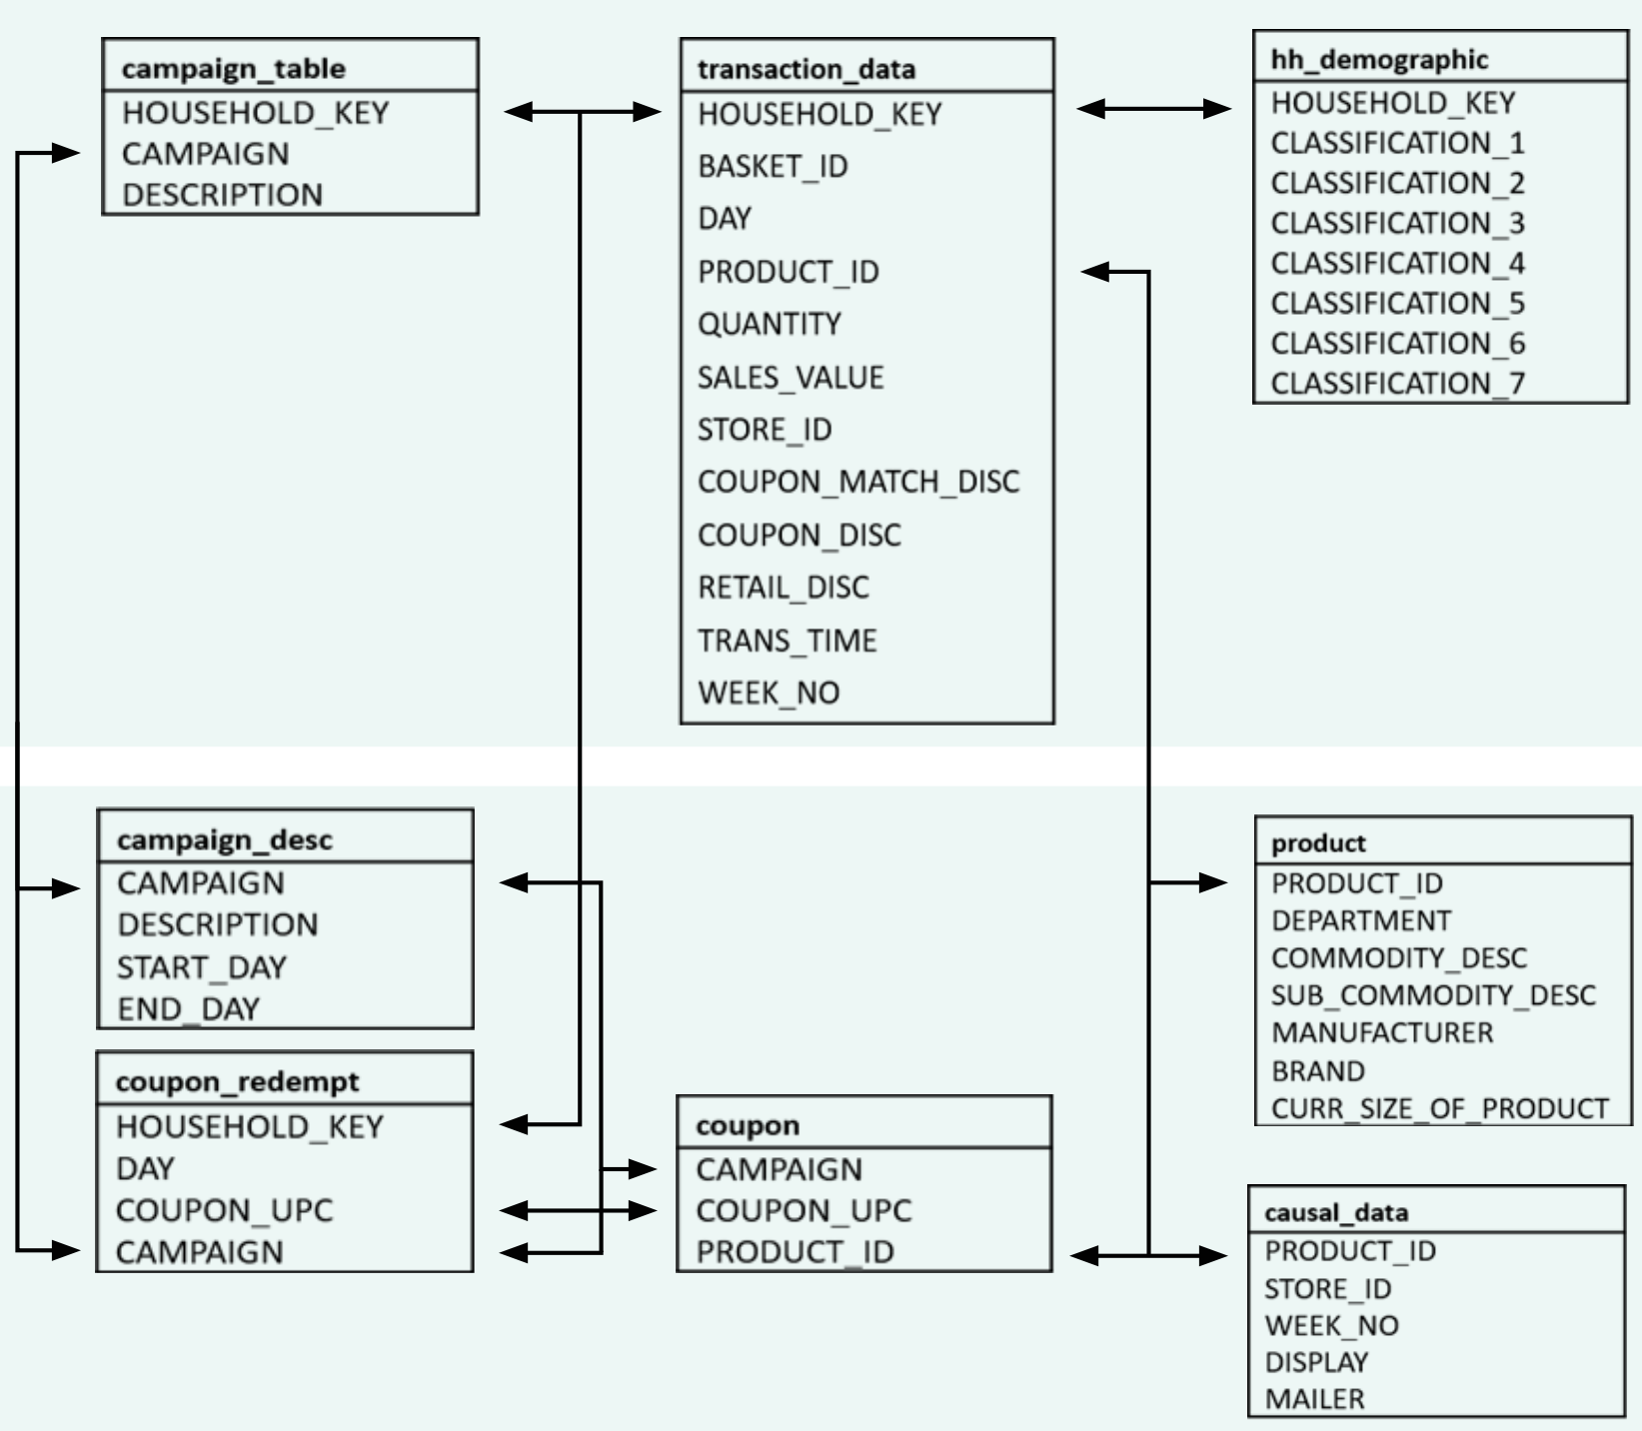
DATA CLEANING AND PREPARATION
Filtered required data and joined datasets using ERD.
Derived new columns (e.g., week, month, quarter) and calculated aggregations - % sales growth, market share and coupon redemption rates at weekly, monthly and quarterly level to enhance model's prediction ability.
Prepared a final filtered dataset with manufacturers 69, 2852, and 2854.
Entity Relationship Diagram

Slide 10
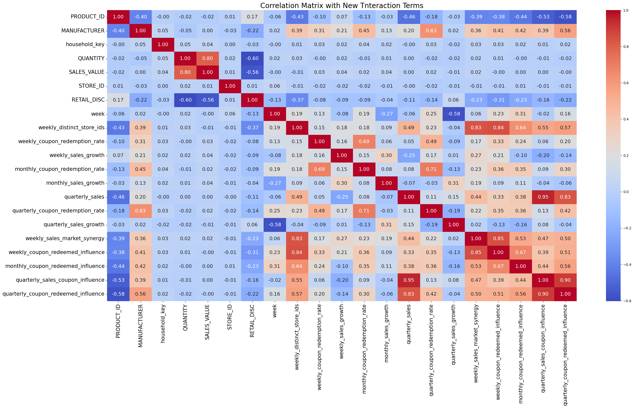
DATA PRE-PROCESSING
Handling Missing Data: Appropriately imputed missing values in the dataset to ensure data integrity.
Feature Engineering: Created dummy variables for categorical columns, including `age group`, `Homeowner Desc`, `mailer`, and `display`, to enable model compatibility.
Multicollinearity Analysis: Assessed multicollinearity between columns by calculating the variance inflation factor (VIF) and addressing highly correlated features to reduce redundancy.

Slide 11
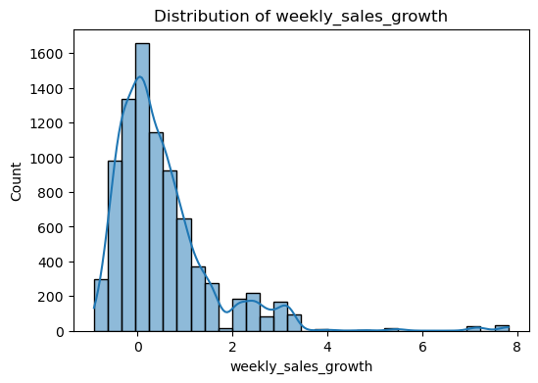
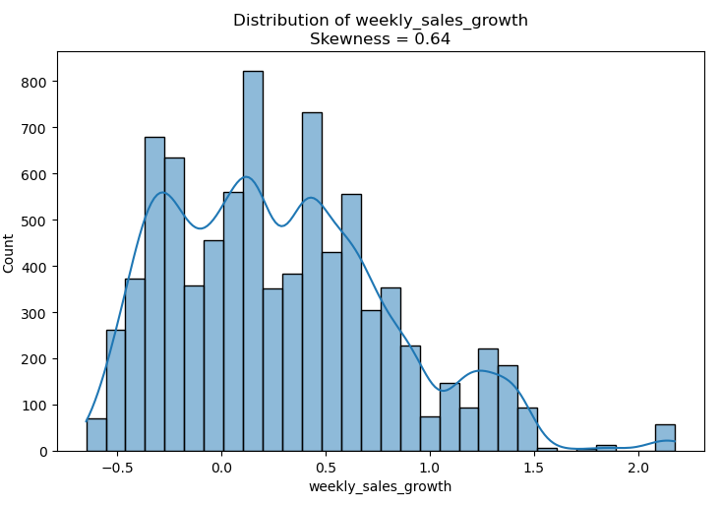
DATA PREPROCESSING
4. Interaction Terms: Added interaction terms for highly correlated variables to capture complex relationships and plotted an updated correlation matrix to verify the improvements. For instance,
quarterly sales coupon influence = quarterly sales * quarterly coupon count
quarterly sales market synergy = quarterly sales * quarterly market share
quarterly coupon redeemed influence = quarterly coupon count * quarterly redeemed coupon count
5. Transformation: Checked column distributions and applied transformations (log/sqrt) to normalize skewed columns.

Slide 12
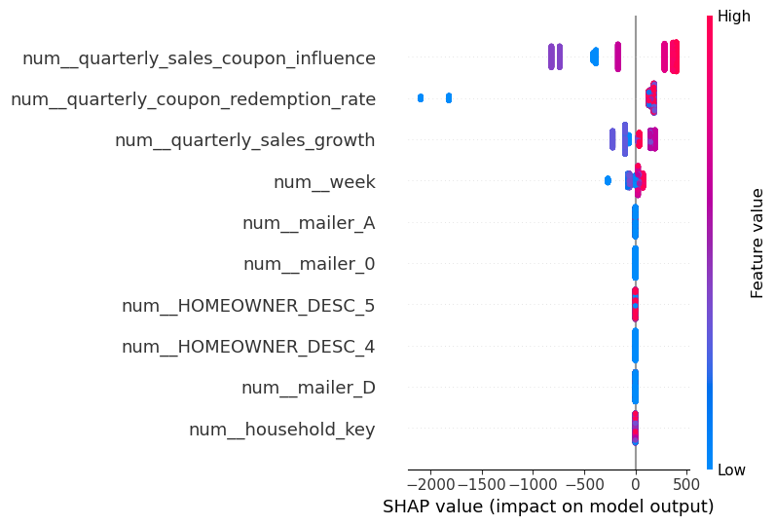
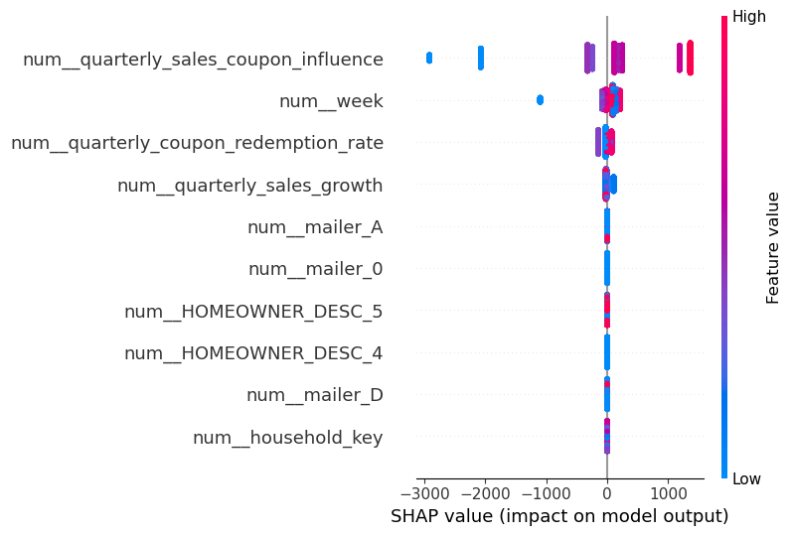
Feature Selection
Used SHAP to identify important predictors for each manufacturer:
SHAP Results for Focal Brand
SHAP Results for Competitor Brand
Coupon Influence: Both brands heavily rely on coupon influence for sales, but the competitor demonstrates a higher dependence, as seen in the broader spread of SHAP values for quarterly sales coupon influence.
Weekly Trends: The competitor brand exhibits a stronger alignment with weekly trends, indicating effective time sensitive promotional campaigns.
Sales Growth: Both brands benefit from sales growth metrics, but the focal brand has a slightly higher dependency on
growth trends compared to the competitor.

Slide 13
Sales prediction models
Model 1: Linear Regression
1. Manufacturer 69 (Focal Brand):
Significant Features: num quarterly sales coupon influence (+484.9152); num quarterly coupon redemption rate (+90.3241); num quarterly sales growth (+66.4119)
Insignificant Features: monthly coupon redemption rate; STORE ID; weekly distinct store ids; num mailer D
2. Manufacturer 2852 (Competitor 1):
Significant Features: num quarterly coupon redemption rate (+386.2428); num week (205.7888); num mailer A (+23.9112)
Insignificant Features: mailer A HOMEOWNER DESC 3; HOMEOWNER DESC 5; mailer 0
3. Manufacturer 2854 (Competitor 2):
Significant Features: num quarterly sales coupon influence (+707.5119); num quarterly sales growth (+65.5781); num HOMEOWNER DESC 3 (+3.3444)
Insignificant Features: week; quarterly sales growth; STORE ID; SALES VALUE

Slide 14
SALES PREDICTION MODELS
Model 2: Random Forest
1. Manufacturer 69 (Focal Brand):
Significant Features: quarterly sales coupon influence quarterly coupon redeemed influence ; quarterly coupon redemption rate ; quarterly sales growth
Insignificant Features: STORE ID, weekly sales growth, and weekly distinct store ids
2. Manufacturer 2852 (Competitor 1):
Significant Features: quarterly sales coupon influence; quarterly coupon redeemed influence ,quarterly coupon redemption rate
Insignificant Features: Promotional mailers (mailer A, mailer 0) and homeowner descriptors have negligible impact.
3. Manufacturer 2854 (Competitor 2):
Significant Features: quarterly coupon redeemed influence, quarterly sales coupon influence, quarterly coupon redemption rate
Insignificant Features: Retail discounts, store operations, and household keys have no measurable impact.

Slide 15
SALES PREDICTION MODELS
Model 3: XG Boost
1. Manufacturer 69 (Focal Brand):
Significant Features: quarterly coupon redemption rate ; quarterly sales coupon influence
Insignificant Features:(quarterly sales growth, week, PRODUCT ID, mailer A)
2. Manufacturer 2852 (Competitor 1):
Significant Features: quarterly sales coupon influence; quarterly sales growth, quarterly coupon redemption rate
Insignificant Features: week, PRODUCT ID, mailer A
3. Manufacturer 2854 (Competitor 2):
Significant Features: quarterly sales coupon influence
Insignificant Features: week, quarterly sales growth, mailer D,

Slide 16
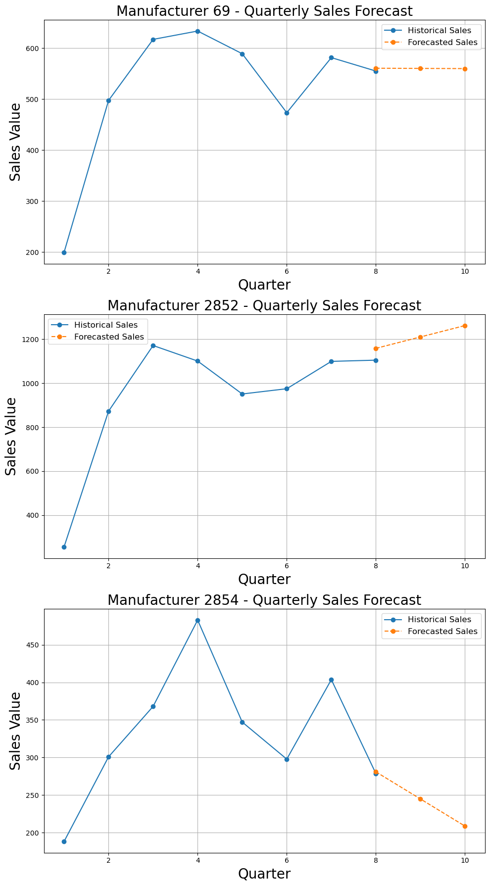

Quarterly SALES forecasting
Manufacturer 69:
The forecast suggests a lack of significant growth in the upcoming quarters, highlighting the need for Manufacturer 69 to reassess and enhance its marketing strategies to drive overall growth.

Slide 17
Quarterly SALES forecasting
Manufacturer 2852: The forecasted sales demonstrate substantial growth in the upcoming quarters, indicating that Manufacturer 2852 will continue to dominate the primal beef market through its highly effective promotional strategies.
Manufacturer 2854: In line with previous trends, Manufacturer 2854 is projected to face challenges in stabilizing sales growth, with a significant decline anticipated unless aggressive marketing campaigns are reintroduced.

Slide 18
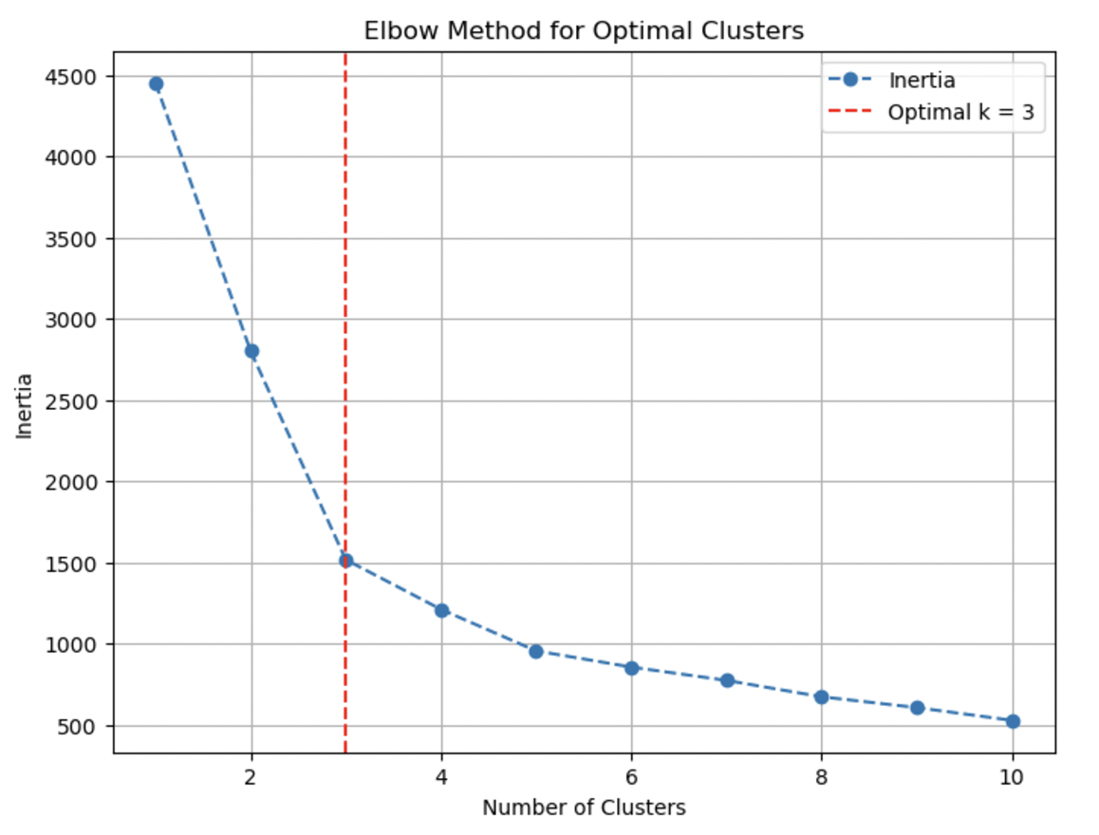
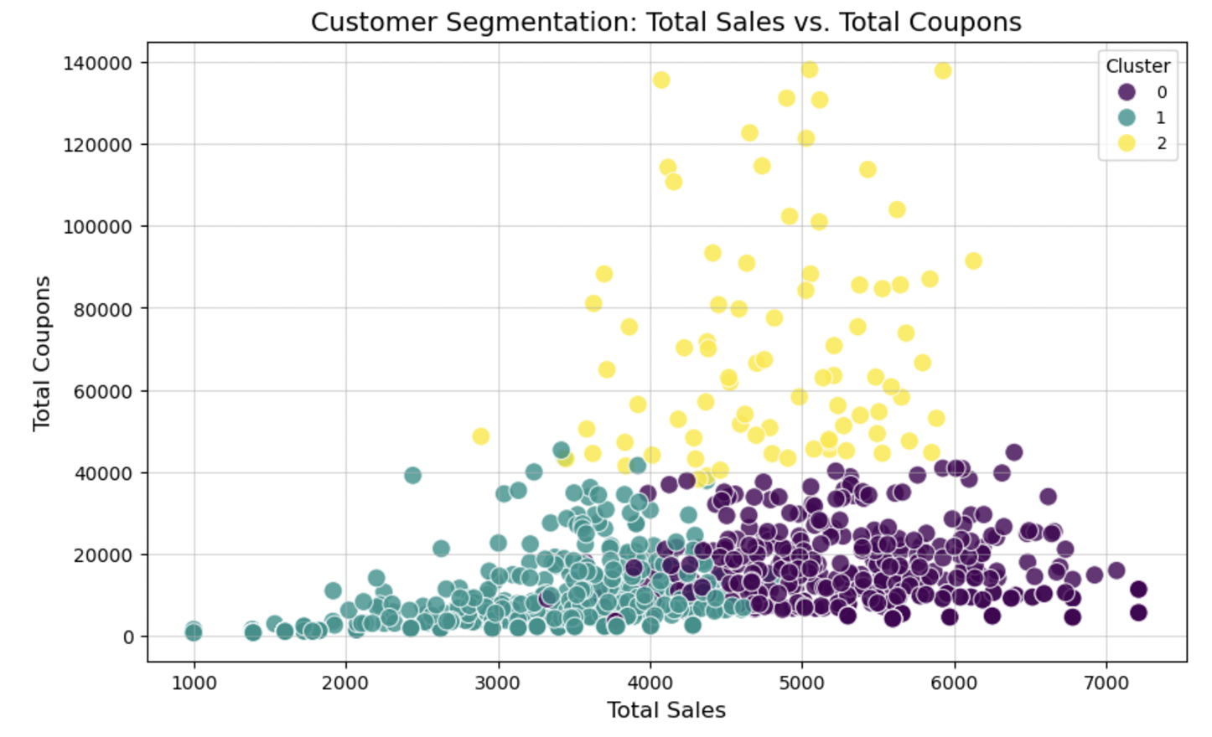
CLUSTER analysis
GOAL: CUSTOMER SEGMENTATION BASED ON BUYING INTENT
Used Elbow Method to identify ideal number of clusters based on household key
Used KMeans clustering to identify 3 clusters
Checked the curve to understand the data, and formed intuitive names for each segment:
Cluster 0: High-value customers
Cluster 1: Cautious spenders
Cluster 2: Engaged buyers

Slide 19
CLUSTER analysis
Model Insights and Recommendations
Cluster 0 (High-value Customers)
Focus on maintaining their loyalty through targeted campaigns for value-added services or bundled offers.
They are the most profitable group; retaining them is critical.
Cluster 1 (Cautious Spenders)
Offer tailored campaigns with steep discounts or promotions to drive sales and engagement.
Explore ways to up-sell or cross-sell products with minimal price increases.
Cluster 2 (Engaged Buyers)
Limit excessive coupon distribution to balance profitability while maintaining their engagement.
Focus on personalized offers that encourage larger basket sizes or premium product purchases.
Based on these results, “Buyer Class” column was created.

Slide 20
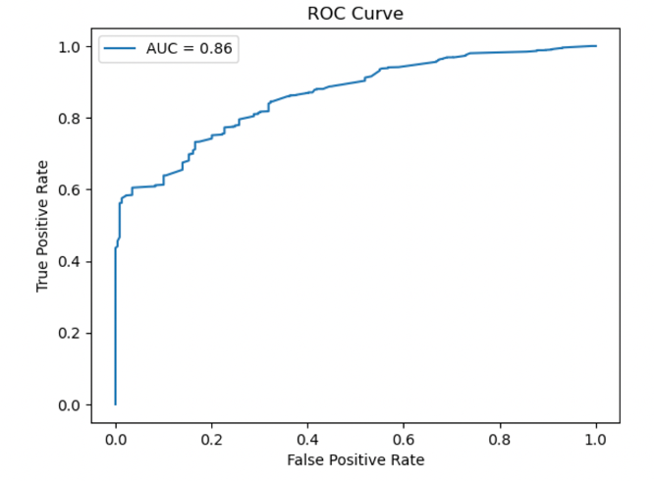
Coupon redemption model
Logistic Regression on Coupon Redemption:
Objective: Understand factors influencing coupon redemption.
Approach: Recursive Feature Elimination (RFE) to select top predictors.
Logistic regression on selected predictors:
Significant Predictors: classification 1, mailer, MANUFACTURER, HOMEOWNER DESC, KID CATEGORY DESC, Buyer Class.

Slide 21
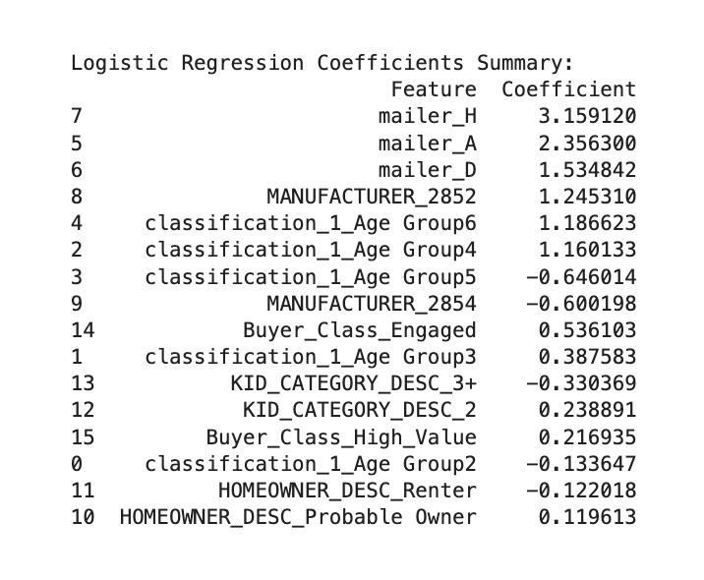
Coupon redemption model
Logistic Regression on Coupon Redemption (continued)
Mailer Impact:
Mailer H has the strongest positive effect on redemption likelihood.
Other mailers show varying impacts, with mailer D having moderate influence.
Customer Segments:
Age Group 4 and engaged buyers show higher likelihood of coupon redemption as also seen in our initial EDA.
Manufacturer 2852 outperforms Manufacturer 69 by leveraging these segments effectively.

Slide 22

Coupon redemption model
Model Insights and Recommendations
Mailer Effectiveness: Mailer H drives the highest coupon redemption, followed by mailers A and D. Tailored mailer strategies for each target segment can improve redemption rates.
Age Group Trends: Age Groups 4 and 6 are the most likely to redeem coupons, while Age Group 5 is less responsive.
Manufacturer Comparison: Manufacturer 2852 performs better in driving coupon redemption than Manufacturer 69, whereas Manufacturer 2854 underperforms.
Household and Buyer Class: Engaged and high value buyer classes exhibit greater redemption likelihood. Cautious customers show the lowest likelihood, suggesting an opportunity for better targeted campaigns. Households with more kids tend to redeem fewer coupons.
Figure: Example of Wrap Front Feature (Mailer H)

Slide 23
INSIGHTS SUMMARY
Sales Prediction:
From Manufacturer 2852 (Competitor 1):
Drive Quarterly Sales Growth: 2852 achieves significant contributions from sales growth. 69 should focus on:
Sustained customer acquisition campaigns.
Better inventory planning and promotions to ensure consistent growth throughout the quarter.
Boost Coupon Influence: Although 69 is moderately successful, it lags behind 2852. Strategies to adopt:
Use personalized and targeted coupon campaigns.
Experiment with tiered coupon values to appeal to a broader customer base.
Should increase coupon influence and improve coupon redemption rates, taking inspiration from 2852
From Manufacturer 2854 (Competitor 2): 2854 s coupon influence is the strongest across all models. 69 can:
Study 2854 s coupon distribution methods to increase reach.
Optimize the messaging and timing of coupon campaigns to maximize their impact.
Manufacturer 69s num household key coefficient is negative, indicating that targeting certain household keys might not be effective. 2852 and 2854 show smaller (positive or neutral) effects for this feature.
2852 experiences a drop in sales as weeks progress during the quarter. 69 should proactively address similar trends by introducing mid-quarter promotions to sustain sales momentum.
Revise or replace ineffective campaigns like Mailer D and optimize others to drive greater sales impact

Slide 24
INSIGHTS SUMMARY
2. Customer Segments
Customers can be ideally segmented into 3 classes based on their purchasing intent
For our focal brand, Manufacturer 69, High-value Customers are the most important segment
Around 46% of the customers in the dataset contribute just 18% revenue for Manufacturer 69. This group (Cautious spenders) should be avoided in marketing campaigns.
3. Coupon Redemption
Whether a customer will redeem a coupon heavily depends on buyer class, where they saw the ad, & their age.
Customers exposed to wrap-front feature ads are 3.16 times more likely to redeem a coupon, making it a highly effective format for Manufacturer 69 to invest in.
Manufacturer 2854, whose sales are lower than our focal brand also see a boost in sales when coupon promotions are used. This demonstrates that competitors are implementing more compelling offers, underscoring a need for 69 to rethink its promotional strategies.

Slide 25
Conclusions and Recommendations
What Manufacturer 2852 is Doing Right:
1. Aggressive Coupon Strategies:
Higher coupon redemption rates drive engagement and sales effectively.
Coupons are tailored and impactful, resulting in dominance in the Primal Beef category.
2. Sustained Sales Growth:
Quarterly sales growth is a key driver, indicating a well-rounded sales strategy beyond coupons.
3. Balanced Promotional Strategy:
Combines coupon influence, redemption, and sales growth effectively for consistent performance.
4. Campaign Timing:
Initial quarter sales show strong momentum, even though they decline later.
Learnings for Manufacturer 69:
Adopt aggressive coupon strategies to improve influence and redemption rates.
Implement sustained customer acquisition campaigns to replicate the quarterly sales growth.
Address potential sales dips by introducing mid-quarter promotions to sustain momentum.

Slide 26
Conclusions and Recommendations
What Manufacturer 2854 is Doing Right:
Maximizing Coupon Influence: Strongest impact on sales suggesting highly effective distribution methods.
Focused Coupon Reliance: Leveraging coupons as the primary driver of sales, especially in campaigns targeting specific segments.
Weaknesses:
Over-Reliance on Coupons: Minimal contributions from other factors (e.g., sales growth), limiting long-term sustainability.
Lower Overall Sales: Despite high coupon effectiveness, total sales remain lower than Manufacturer 69 and 2852.
Learnings for Manufacturer 69:
Study 2854’s coupon distribution methods to enhance reach and optimize the messaging and timing of coupon campaigns.
Avoid over-reliance on coupons by incorporating additional growth strategies like seasonal promotions or customer loyalty programs.

Slide 27

Conclusions and Recommendations
What Manufacturer 69 is Doing Right:
Steady Sales from Brand Value: Sales remain consistent due to strong store presence and brand recognition.
Coupon Redemption Rates: Moderate impact on sales, showing success in influencing customer behaviour through coupons.
Wrap-Front Ads: Customers exposed to wrap-front ads are 3.16 times more likely to redeem coupons, making this an effective promotional channel.
Key Customer Segments: High-value buyers and Age Group 4 are the most responsive and profitable customer segments.

Slide 28
Conclusions and Recommendations
Areas for Improvement:
Personalize and target coupon campaigns: Experiment with tiered coupon values to cater to diverse customer segments.
Boost Redemption Rates: Learn from 2852’s effective campaigns to improve redemption rates further.
Sales Growth: Minimal contribution from quarterly sales growth indicates limited efforts in sustaining momentum.
Focus on sustained customer acquisition campaigns.
Inventory planning and targeted mid-quarter promotions.
Ineffective Campaigns: Certain campaigns like Mailer D show low impact and need to be revised or replaced with higher-performing channels like Mailer H.
Household-Level Targeting: Negative coefficient for "num household key" suggests that some household segments are not worth targeting. Refocus on high-value households.
Avoid Cautious Spenders: Around 46% of customers contribute just 18% of revenue. Avoid targeting this segment to optimize marketing ROI.
Diversify Strategies Beyond Coupons: While coupons are critical, 69 should explore additional promotional formats (e.g., bundled offers, loyalty programs) to reduce over-reliance on one strategy.

Slide 29
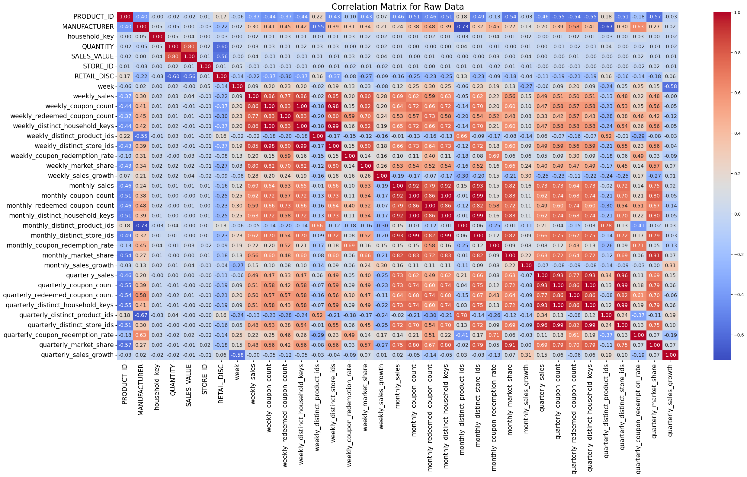
Correlation MAp(before interaction terms)

Slide 30

Correlation MAp(After interaction terms)
Interaction Terms Created
weekly sales market synergy = weekly sales weekly market share
weekly coupon redeemed influence = weekly coupon count weekly redeemed coupon count
monthly sales market synergy = monthly sales monthly market share
monthly coupon redeemed influence = monthly coupon count monthly redeemed coupon count
quarterly sales coupon influence = quarterly sales quarterly coupon count
quarterly sales market synergy = quarterly sales quarterly market share
quarterly coupon redeemed influence = quarterly coupon count quarterly redeemed coupon count
quarterly distinct synergy = quarterly distinct household keys quarterly distinct product ids

Slide 31
Transformations applied
Column | Skewness
age group | 0.459332 5
display | 22.845876 4
distinct household keys | 0.730818 10
distinct product ids | 0.071136 11
distinct store ids | 0.494672 12
HOMEOWNER DESC | 0.731697 6
month | 0.033072 8
monthly coupon redeemed influence | 1.974663 23
monthly coupon redemption rate | 0.326819 16
Monthly sales growth | 1.963506
QUANTITY | 11.864838 1
quarter | 0.001040 9
quarterly coupon redeemed influence | 0.136900
quarterly coupon redemption rate | 0.608622 19
quarterly sales | 0.423598 18
quarterly sales coupon influence | 0.149310 24
quarterly sales growth | 2.364323 20
RETAIL DISC | 18.812900 3
SALES VALUE | 11.514805 2
week | 0.034496 7
weekly coupon redeemed influence | 1.684833 22
weekly coupon redemption rate | 0.516426 14
weekly distinct store ids | 0.494672 13
weekly sales growth | 2.655323 15
weekly sales market synergy | 1.448908 21
Log Transformation: applied to highly positively skewed data to reduce skewness and make the distribution closer to normal.
QUANTITY
SALES VALUE
RETAIL DISC
weekly sales growth
monthly sales growth
quarterly sales growth
Sqrt Transformation used for moderately skewed data to reduce the spread of the larger values while maintaining data distribution symmetry.
weekly sales coupon influence
weekly sales market synergy
weekly coupon redeemed influence
monthly sales coupon influence
monthly coupon redeemed influence
weekly distinct synergy

Slide 32
LINEAR REGRESSION MODEL
Model Results for Each Manufacturer:
Manufacturer 69:
Model Equation: y = 3204.9230 + (0.1729 * num household key) + (-0.4101 * num QUANTITY) + (0.0588 * num SALES VALUE) + (1.0912 * num STORE ID) + (2.7289 * num RETAIL DISC) + (-30.7830 * num week) + (-21.5639 * num weekly distinct store ids) + (-21.3108 * num weekly coupon redemption rate) + (-13.2835 * num weekly sales growth) + (-25.3734 * num monthly coupon redemption rate) + (-36.8596 * num monthly sales growth) + (277.7956 * num quarterly coupon redemption rate) + (45.9993 * num quarterly sales growth) + (-0.1176 * num age group 1) + (0.8436 * num age group 2) + (0.7156 * num age group 3) + (0.0962 * num age group 4) + (-0.4988 * num age group 5) + (0.0595 * num age group 6) + (-1.1494 * num HOMEOWNER DESC 2) + (0.2079 * num HOMEOWNER DESC 3) + (0.4862 * num HOMEOWNER DESC 4) + (0.7069 * num HOMEOWNER DESC 5) + (53.3684 * num mailer 0) + (2.8095 * num mailer A) + (-4.6216 * num mailer D) + (3.7653 * num mailer H) + (6.9615 * num display 2.0) + (-13.3682 * num display 4.0) + (23.8868 * num weekly sales market synergy) + (30.9629 * num weekly coupon redeemed influence) + (22.7040 * num monthly coupon redeemed influence) + (585.7197 * num quarterly sales coupon influence) + (-326.5616 * num quarterly coupon redeemed influence)
Mean Squared Error (MSE): 1207.9000
R-squared (R²): 0.9988
Manufacturer 2852:
Model Equation: y = 3170.4792 + (2.6668 * num household key) + (1.7657 * num QUANTITY) + (-2.2250 * num SALES VALUE) + (0.4443 * num STORE ID) + (2.0411 * num RETAIL DISC) + (-84.9626 * num week) + (3.6067 * num weekly distinct store ids) + (5.5410 * num weekly coupon redemption rate) + (14.5838 * num weekly sales growth) + (21.9616 * num monthly coupon redemption rate) + (-30.5708 * num monthly sales growth) + (544.3997 * num quarterly coupon redemption rate) + (65.5756 * num quarterly sales growth) + (-1.1483 * num age group 1) + (-1.8779 * num age group 2) + (1.4851 * num age group 3) + (1.6281 * num age group 4) + (2.2206 * num age group 5) + (0.8910 * num age group 6) + (1.7750 * num HOMEOWNER DESC 2) + (3.0867 * num HOMEOWNER DESC 3) + (-0.0651 * num HOMEOWNER DESC 4) + (-0.6101 * num HOMEOWNER DESC 5) + (-0.0000 * num mailer 0) + (12.1075 * num mailer A) + (-15.8307 * num mailer D) + (15.0576 * num mailer H) + (-0.0000 * num display 2.0) + (0.0000 * num display 4.0) + (5.5436 * num weekly sales market synergy) + (-11.5201 * num weekly coupon redeemed influence) + (-3.6156 * num monthly coupon redeemed influence) + (412.1219 * num quarterly sales coupon influence) + (-136.5439 * num quarterly coupon redeemed influence)
Mean Squared Error (MSE): 10098.4208
R-squared (R²): 0.9926
Manufacturer 2854:
Model Equation: y = 2475.4214 + (0.8009 * num household key) + (0.3246 * num QUANTITY) + (-0.5365 * num SALES VALUE) + (-0.8980 * num STORE ID) + (0.2872 * num RETAIL DISC) + (4.7854 * num week) + (-22.8375 * num weekly distinct store ids) + (0.4626 * num weekly coupon redemption rate) + (-8.0336 * num weekly sales growth) + (29.0863 * num monthly coupon redemption rate) + (17.8473 * num monthly sales growth) + (39.1480 * num quarterly coupon redemption rate) + (48.4410 * num quarterly sales growth) + (-0.3955 * num age group 1) + (0.8680 * num age group 2) + (0.2692 * num age group 3) + (0.7815 * num age group 4) + (-0.3712 * num age group 5) + (3.1293 * num age group 6) + (0.7906 * num HOMEOWNER DESC 2) + (2.0000 * num HOMEOWNER DESC 3) + (0.5796 * num HOMEOWNER DESC 4) + (-1.0871 * num HOMEOWNER DESC 5) + (-0.0000 * num mailer 0) + (8.5006 * num mailer A) + (0.0000 * num mailer D) + (0.0000 * num mailer H) + (-0.0000 * num display 2.0) + (0.0000 * num display 4.0) + (23.2569 * num weekly sales market synergy) + (-1.6913 * num weekly coupon redeemed influence) + (-58.4977 * num monthly coupon redeemed influence) + (914.6247 * num quarterly sales coupon influence) + (-195.4430 * num quarterly coupon redeemed influence)
Mean Squared Error (MSE): 3201.6282
R-squared (R²): 0.9942

Slide 33
RANDOM FOREST MODEL
Feature Importance
FOCAL BRAND 69
COMPETITOR BRAND 2852
COMPETITOR BRAND 2854
Feature | Importance
num quarterly sales coupon influence | 0.497681
num quarterly coupon redeemed influence | 0.270811
num quarterly coupon redemption rate | 0.216363
num quarterly sales growth | 0.011271
num week | 0.00277
num monthly coupon redemption rate | 0.001104
num RETAIL DISC | 1.08E-15
num STORE ID | 1.04E-15
num household key | 9.44E-16
num SALES VALUE | 4.90E-16
Feature | Importance
num quarterly sales coupon influence | 0.585957
num quarterly coupon redeemed influence | 0.302051
num quarterly sales growth | 0.08887
num quarterly coupon redemption rate | 0.018478
num week | 0.004645
num household key | 3.40E-14
num RETAIL DISC | 2.50E-14
num SALES VALUE | 1.62E-14
num STORE ID | 1.25E-14
num weekly sales market synergy | 8.27E-15
Feature | Importance
num quarterly coupon redeemed influence | 0.571547
num quarterly sales coupon influence | 0.413512
num quarterly coupon redemption rate | 0.006498
num quarterly sales growth | 0.004646
num week | 0.003797
num household key | 4.58E-15
num RETAIL DISC | 4.32E-15
num STORE ID | 3.51E-15
num SALES VALUE | 3.25E-15
num weekly sales growth | 2.46E-15

